Slide 1
Epic Meal Slime
Rebecca Tester & Matthew Satterfield

Slide 2

High Concept
Help a hungry slime in a big city navigate through pillars and get food by clicking when it’s safe to snack.

Slide 3
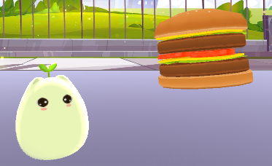
Genre & Theme
Colorful Casual Action
Fantasy and Food
Notes:
Game based off the Omnivore theme

Slide 4


Core Mechanics
Aiming and Jumping through pillars to get food.
Get food to avoid starving.
Get food quickly enough to fill up the slime’s hunger completely and win.

Slide 5
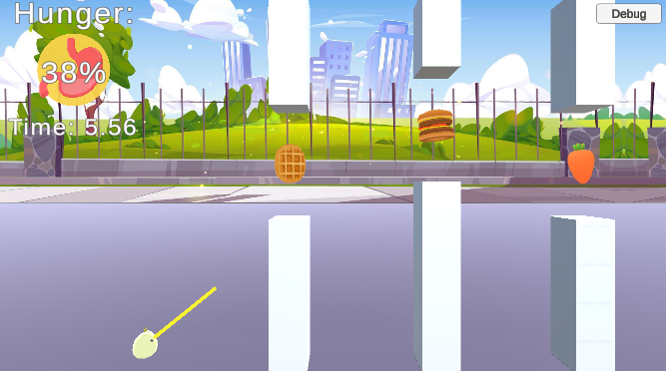
Gameplay
Jumping - Click or press Space.
Aiming - Automatic. Time your jumps.
Hunger - Depletes, but food increases. 0% lose, 100% win.
Notes:
Jumping - Click or press Space to jump and advance to the next pillar
Aiming - An aiming line automatically goes up and down, time your jumps to go through the pillars and get food.
Hunger - Your hunger depletes over time and increases when you get food. Reach 0% and you starve, but reach 100% and you win.

Slide 6

Fun Factor
Trying to beat your best time.
Tension between hunger depleting and aiming.
Easy replayability.

Slide 7
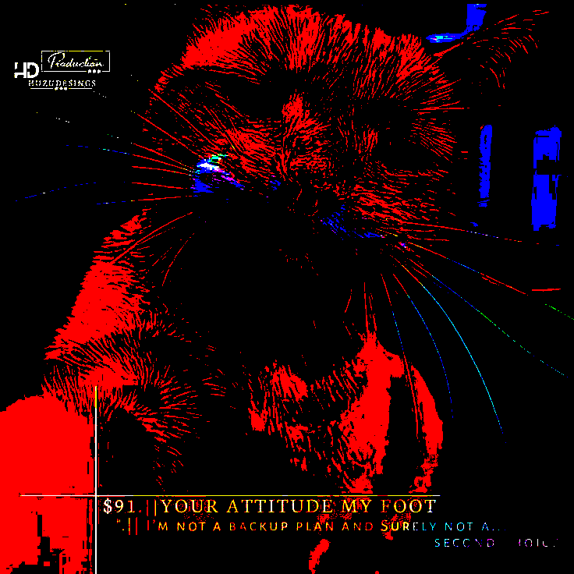

Images in presentation, delete this slide when done

